Slide 1
Exploratory Testing
Prepared by: Rafał Nikiel
6 November 2015
Version: 1.0

Slide 2

Agenda
What’s wrong with scripted testing ?
What is exploratory testing
SBTM
Task 2
Summary

Slide 3
Scripted testing – quick summary
Dividing test design from the test execution
Suppresses thinking out of test execution
Step by step instructions with a pass/fail criteria based on set of expected results
Commonly utilizes different resources for test design and execution
Can be both manual or automated
Executed many times
Properly used together with tracabilty matrix can give nice coverage statistics
Assumes the product is “locked down”
Requires lots of planning and documentation
Good candidate for automation

Slide 4
Scripted testing – what’s wrong with this approach?
Excercise
Less likely to find the most important and complex bugs
Inattentional blindnes – tester pays attention only to script path

Slide 5
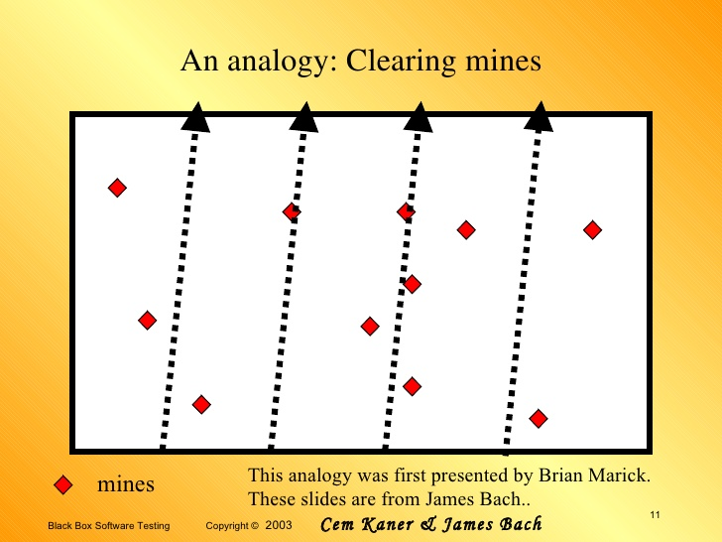
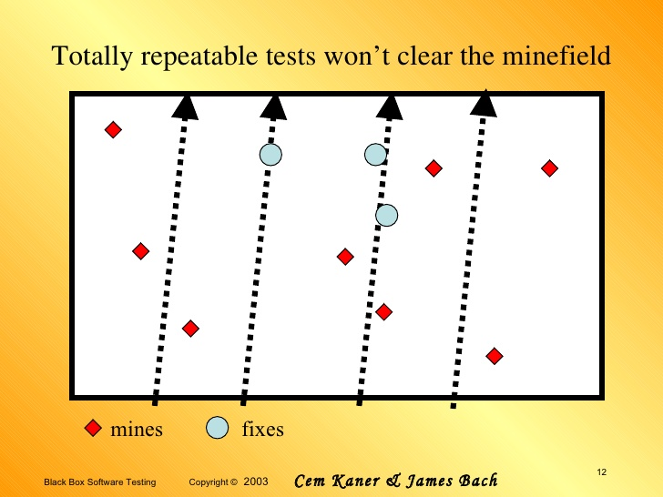
Scripted testing – what’s wrong with this approach?
Checking the same things all the time and missing the same things every time
Notes:
Clearing mines – what if pareto rule will be applied and most of the bugs will appear in one area (not covered by the script)?
If you imagine a product as a field of landmines and each landmine is a defect, then it’s pretty clear that treading the same path over and over is not the way to find them all

Slide 6
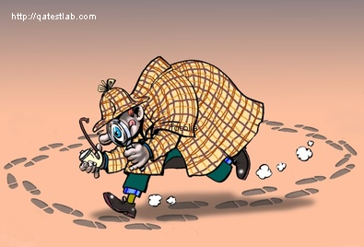
Scripted testing – what’s wrong with this approach?
Quality of scripts = quality of requirements
High cost:
Software can behave and fail in many ways – analogy to crime investigation
Spending time on running scripts that are not finding new bugs
Changes in requirements
A lot of effort for planing and documentation (it might not be valuable)
"Not everything that can be counted counts and not everything that counts can be counted.„
A. Einstein

Slide 7
Exploratory testing – definitions
Cem Kaner
“A style of software testing that emphasizes the personal freedom and responsibility of the individual tester to continually optimize the quality of his work by treating test-related learning, test design, test execution, and test result interpretation” (Kaner C., 1983)
„The plainest definition of exploratory testing is test design and test execution at the same time”
James Bach
The plainest definition of exploratory testing is test design and test execution at the same time”

Slide 8
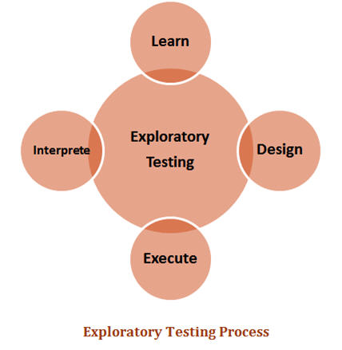
Exploratory testing explained
Exploratory testing is not a testing technique. It's a way of thinking about testing.
Test are designed and executed at the same time
Using conclusion from the fist test as an input to second one
Testers are in control not the test script
Spend more of your tester’s time on core testing activities
Everyone was performing exploratory tests
Tools and techiques – total freedom
ET is not „do random stuff and see what happens”
„If all you have is a hammer, everything loks like a nail”
Notes:
ET jest jak gra w szachy kolejny ruch zawsze zależy od ruchu przeciwnika i aktualnego stanu gry

Slide 9
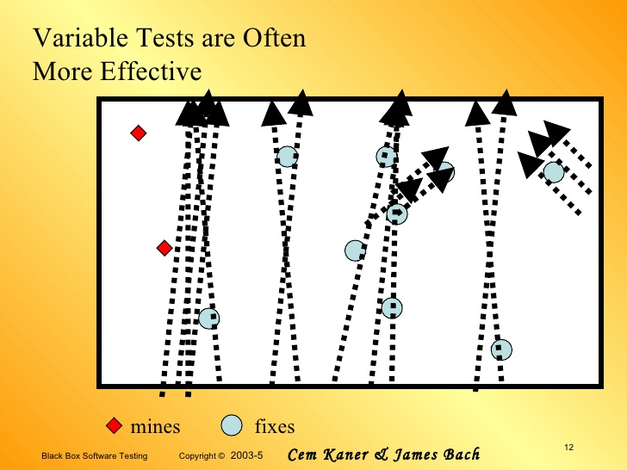
Exploratory testing benefits
More bugs found
Bugs are found earlier
More time spent testing, testing can start earlier
Utilizes tester capabilities and promotes motivation in the testing team
Less preparation is needed, important bugs are found quickly, and the approach tends to be more intellectually stimulating to execute than scripted tests.
Tect cases can be also used but rather to asist tester then fully driving the test activity

Slide 10
Exploratory testing - cons
Tests invented and performed on-the-fly can’t be reviewed in advance and therefore prevent errors in code and test cases. It can be difficult to show exactly which tests have been run.
It’s not so easy to repeat tests or reproduce bugs
Minimizing work with documentation and frequent changes in the test (in most cases follow a hunch rather than a fixed plan) lead to a situation where we lose the transparency of what we do.

Slide 11
Exploratory testing - chalenges
Session Based Test Management
What if a customer requires test reports?
How to define exploratory tests coverage?
How to monitor the progress of the tests?

Slide 12
SBTM - main concept
Charter
Session
A goal or agenda for a test session. Charters are created by the test team prior to the start of testing, but they may be added or changed at any time. Often charters are created from a specification, test plan, or by examining results from previous sessions.
An uninterrupted period of time spent testing, ideally lasting one to two hours. Each session is focused on a charter, but testers can also explore new opportunities or issues during this time. This might be through the use of written notes, video capture tools or by whatever method as deemed appropriate by the tester.
Notes:
Jak powstalo – Bach – zespol od zadan specjalnych. Szybkie znajdywanie bugow ale rowniez raporty z postepu prac dla klienta.
Notatki powinny zawierac fakty, krotkie tresciwe opisy tego na co tester natrafia podczas pracy

Slide 13
SBTM - main concept
Report
Debriefing
The essence of the whole session. Tester write down his activity, which can be divided into different levels (errors, test data, questions, ideas, problems encountered, etc). Sample report.
Should occur after the sessions are done. More experienced testers are giving feedback and deciding how to improve the next sessions. Crucial part to make the SBTM working properly.
Notes:
Jak powstalo – Bach – zespol od zadan specjalnych. Szybkie znajdywanie bugow ale rowniez raporty z postepu prac dla klienta.
Notatki powinny zawierac fakty, krotkie tresciwe opisy tego na co tester natrafia podczas pracy

Slide 14
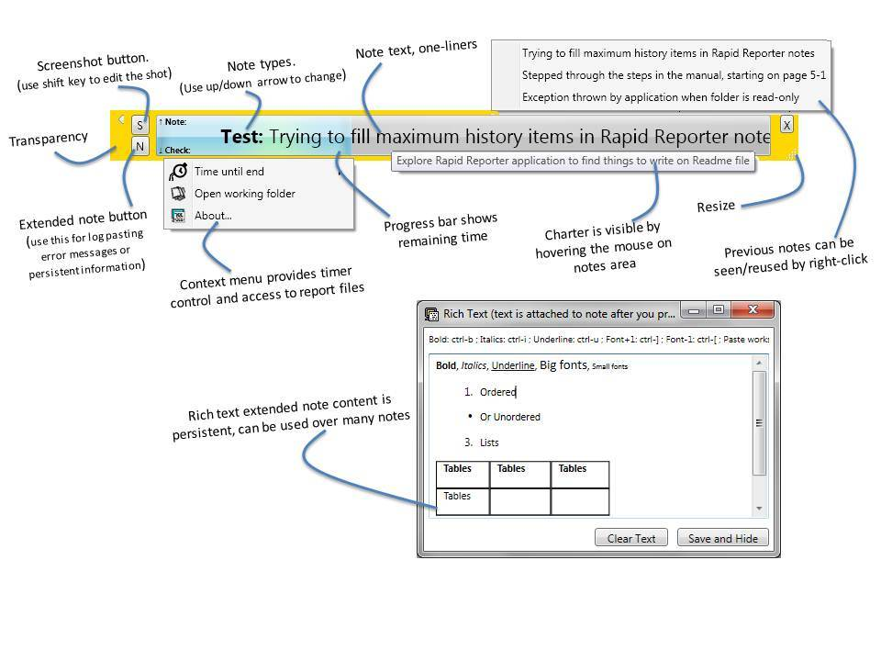
SBTM tools – Rapid reporter
http://testing.gershon.info/reporter/

Slide 15
Task 1
Go to http://www.orangehrm.com/OpenSource.php and expand Features
Chose one of the feature and read the short spec of that functionality
Run Rapid reporter and define your charter
Open following link http://opensource.demo.orangehrmlive.com/
Run your session and remember to take some notes
Convert session report to html format
Send all reports in html format to rafal.nikiel@gft.com or to https://github.com/jacekokrojek/math.uni.lodz.pl

Slide 16
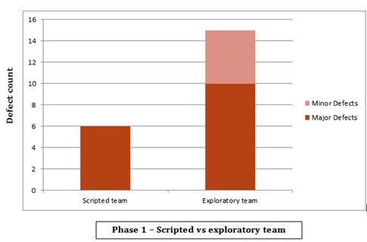
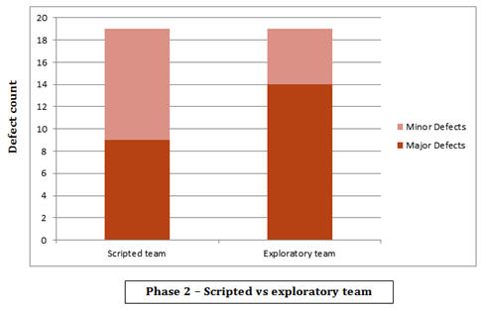
Exploratory testing - Summary
Scripted vs exploratory experiment:
2 teams, 2 aproaches 2 testing phases
In the end, neither approach was perfect, because each team reported defects that the other team did not identify, even if the exploratory team did report more, overall.

Slide 17
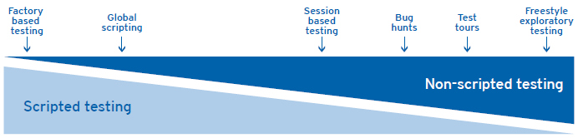
Exploratory testing - Summary
So which approch is the best scripted or exploratory ?
Examples from real world

Slide 18
Exploratory testing - links and materials
http://www.testingeducation.org/BBST/exploratory/BBSTExploring.pdf
http://www.satisfice.com/articles/sbtm.pdf
http://www.kaner.com/pdfs/QAIExploring.pdf
http://www.satisfice.com/articles/what_is_et.shtml
http://www.satisfice.com/articles/et-article.pdf
http://www.testingeducation.org/a/nature.pdf

Slide 19
Thank you!

